Slide 1
Machine Learning Hackathon

Slide 2
Team : The Starks
Members:
Kartik Sachdeva
Aditya Kumar Deshwal
Ankit Jaiswal

Slide 3
Problem Statement: Our client, ElectricCo, is a major utility company providing gas and electricity to corporate, SME and residential customers. In recent years, post-liberalization of the energy market in Europe, ElectricCo has had a growing problem with increasing customer defections above industry average. They would like to identify the drivers of this problem and to devise and implement a strategy to counter it. The churn issue is most acute in the SME division and thus they want it to be the first priority. The head of the SME division has asked whether it is possible to predict the customers which are most likely to churn so that they can trial a range of pre-emptive actions.
Our Task:
What are the most explicative variables indicating churn?
Is there a correlation between subscribed power and consumption?
Is there a link between sales channel and churn?
Build a machine learning model that can predict the customers with high probability of churn.

Slide 4
What are the most explicative variables indicating churn?
price_p1_var
Channel_sales
Cons_gas_12m
Has-gas
Nb_product_Act
Origin_up
Forecast_price_energy_p1
Net_margin
Pow_max

Slide 5
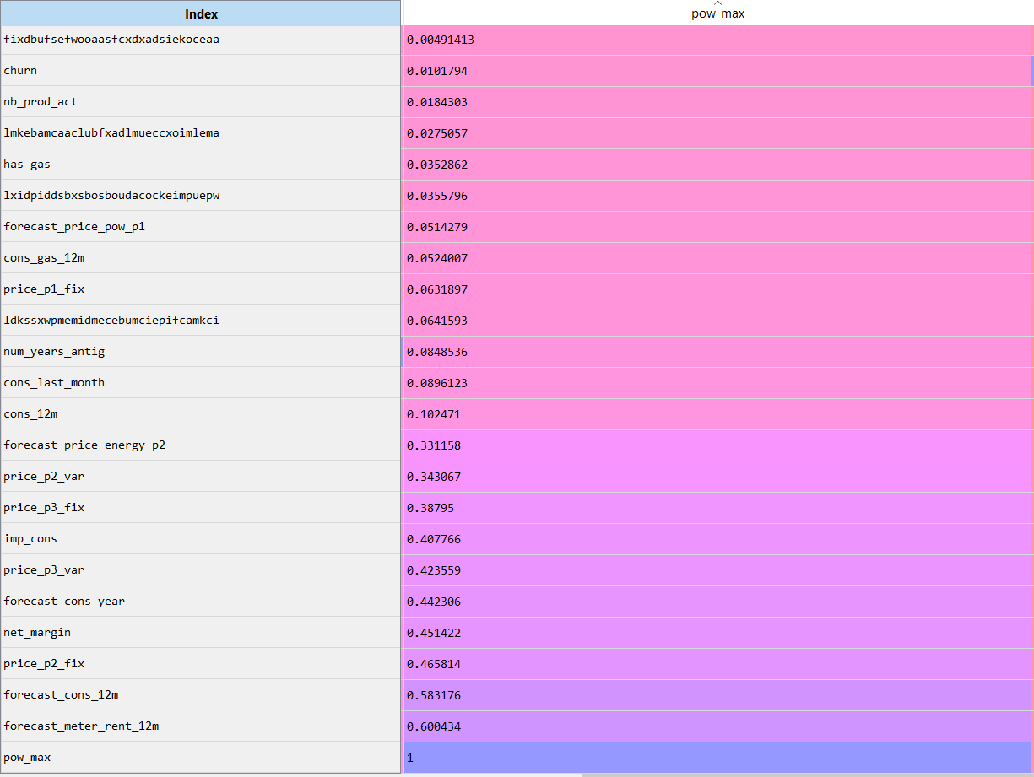
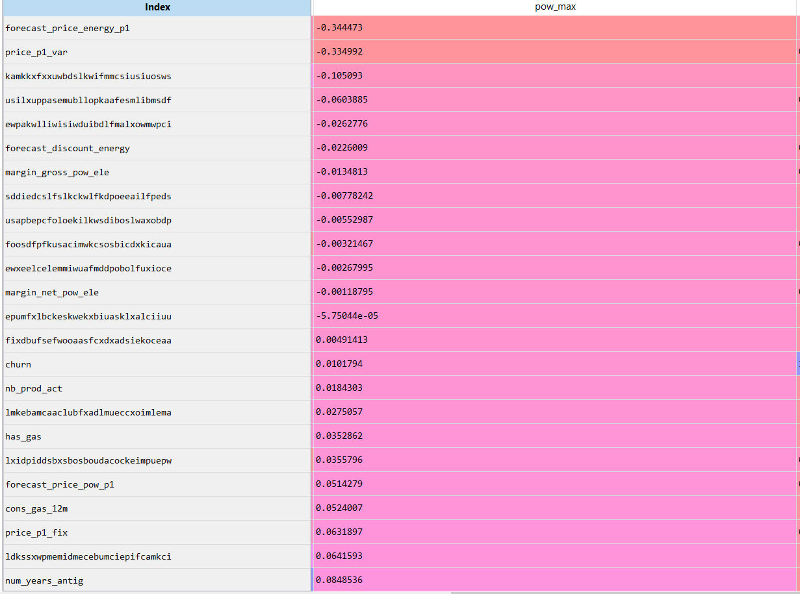
Is there a correlation between subscribed power and consumption?
Cons_12m : 0.1024
Cons_last_month : 0.0896
Conclusion : NO

Slide 6
Is there a link between sales channel and churn?
According to Correlation between sales channels , there are
Links particular to code channel.

Slide 7
Build a machine learning model that can predict the customers with high probability of churn.
Cleaned the data.
Found Correlation between different column vectors.
Used the most explicative variables to build Classifier Model.
Used Logistic Regression Model for classification
Trained the Model with Input Data
Generated the Accuracy : 90.761%

Slide 8
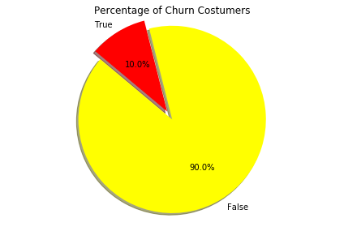
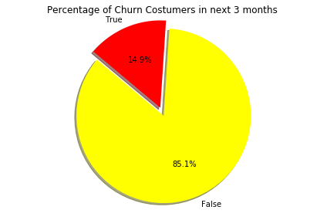
Training Data Existing Churn Amount
Probabilistic amount for churns for next three months
According to trained Model

Slide 9
Thank You..

